Slide 1

SNITCH
SALES DATA
-THARUN SAJEEV

Slide 2
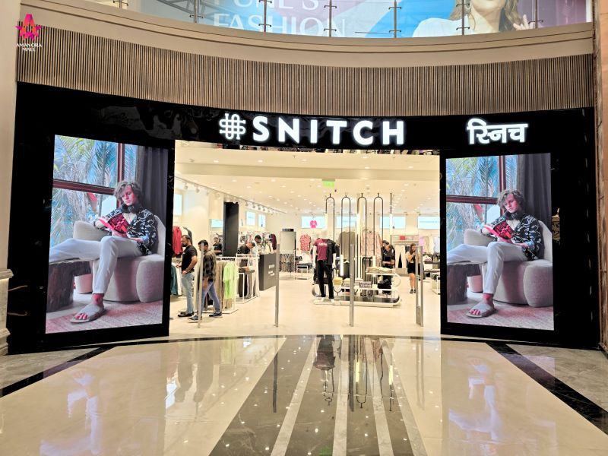
INTRODUCTION
Source: Kaggle
Brand: Snitch — a modern clothing company that focuses on menswear
Nature: Transaction-level retail sales data including product, pricing, profit, discount, city, segment, and order details
Time Period Covered: February 2023 to june 2025

Slide 3

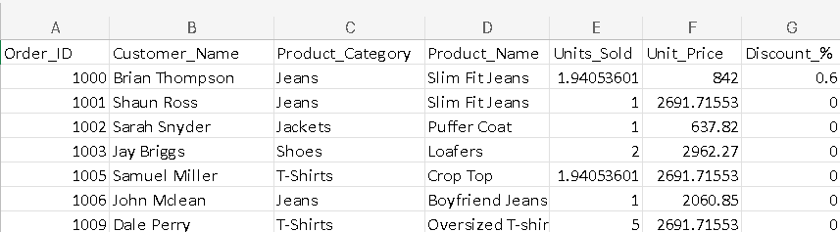
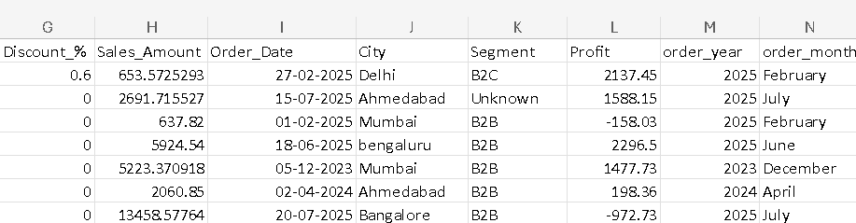
TABLE

Slide 4

KEY INSIGHTS
Total Sales Revenue
Yearly Sales Revenue
Monthly Sales Revenue per Year
Least Revenue Month
Revenue by City
Top-Selling Products
Least-Selling Products
Most Profitable Products
Revenue by Product Category

Slide 5


Top Profitable Product Categories
Average Discount vs Profit
Profit by Discounted vs Non-Discounted Products
Revenue and Profit by Segment
Top Customers by Revenue
Profit by Discount Percentage
Top selling products in accessories

Slide 6
CONCLUSION
Sales Performance Over Time
The company's revenue changes year by year and month by month, showing seasonal trends or marketing effects.
Regional Demand Trends
Some cities consistently generate higher revenue, showing strong customer presence in those regions.
Product Performance
A few products and categories are the most sold and most profitable, showing what customers prefer.
Products with very low sales may need better promotion or could be removed.
Profit Drivers
Top products and categories bring in the most profit, and the company should focus more on them.

Slide 7
Customer Segments
Certain customer types (like B2B or B2C) are more valuable based on revenue and profit, and should be targeted more.
Key Customers
A small number of customers contribute a large amount of revenue.These customers can be given loyalty benefits or targeted offers.

Slide 8
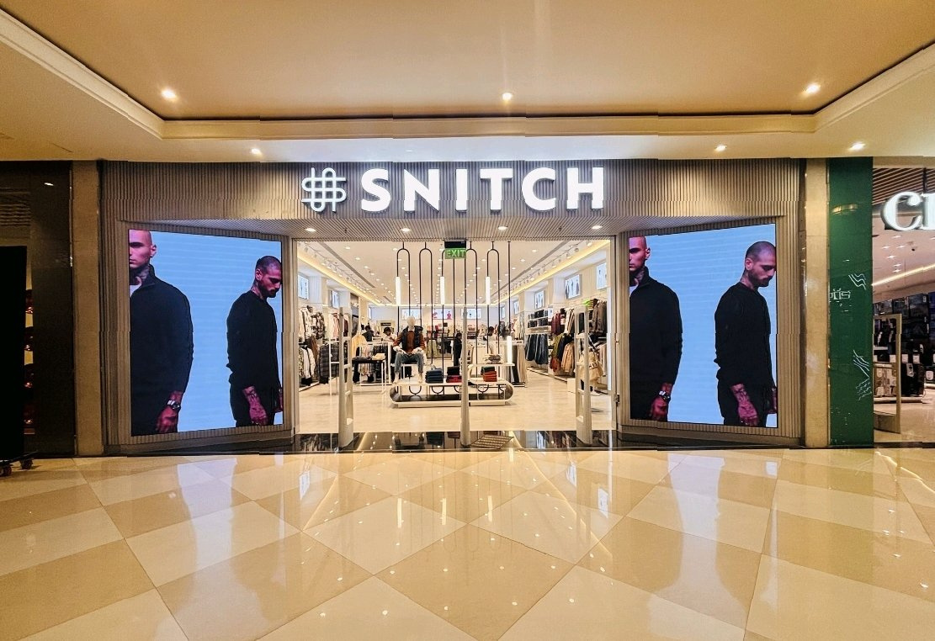
THANK YOU

